Slide 1
Community Justice Workshop
Welcome!!!!
Notes:
https://www.mentimeter.com/app/presentation/aliio4s4xvtbf5bsi1962pifir536x7m (2)
https://www.mentimeter.com/app/presentation/al7tbevbxrhwyyogrnbzuq23nektbvrs ( 1)
LOG In As Drexel

Slide 2
Meet the Presenters
A Collaboration by
Drexel University & Policy Map Inc.
Dr. Cyndi Reed Rickards
Associate Teaching Professor
Director of Justice Studies
Dr. Jazmyne McNeese
Senior Data Services Analyst
Researcher & CED Specialist
Helene Speer
PolicyMap Developer
UX Design and Accessibility Expert

Slide 3
Overview
Intro to Course “Justice in Our Community”
Intro to PolicyMap + Demo
Case Study 1
Case Study 2
Reflection + Takeaways

Slide 4
“Justice in Our Community”
Course Description:
This course is a community-based hybrid course which utilizes in-class lecture, online simulation, Policy Maps and partnerships with a community non-profit to explore agents of justice in our urban community. Through academic readings, in-class active learning and mapping data, students will discover the scholarship of urban issues and community engagement. Using SIMCity, students will manipulate the very agents of justice we read to experience how such agents are intricately linked. At the same time, students will map data to visualize the statistics we explore in class. Additionally, students will partner with a community organization to engage with the agents of justice discussed in class (E.g.: housing, access to healthy food, healthcare, employment, and education). Finally, students will reflect upon their proximity to the issues and the importance of both statistics and community engagement.
Learning Objectives:
Students will:
· Recognize multifaceted justice issues in urban communities
· Analyze who lives in our city
· Discuss the contemporary urban experience
· Review urban policy and social institutions
· Visualize and explore data
· Experience and develop relationships with community partners

Slide 5
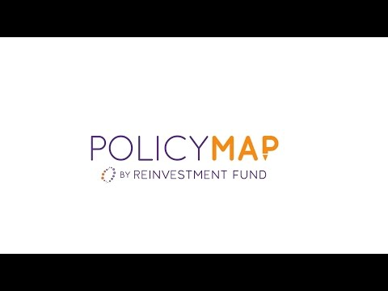
Policy Map Mapping Tool
What is PolicyMap?
We are a nationwide online mapping and data platform that consists of almost 50,000 data indicators from both public and proprietary sources – all available in an easy-to-use mapping and reporting tool. Data covers topics such as demographics, income, housing, jobs, health, education and more. PolicyMap is used for research, market studies, business planning, site selection, grant applications and impact analysis. Our subscribers include federal, state and local government agencies, universities, non-profit organizations, community development financial institutions as well as a lot of recent interest from healthcare and public health sector. We started in 2008 as part of The Reinvestment Fund, a large CDFI based in Philadelphia.
How does it work?

Slide 6
Live Demo
Let’s Map!
Notes:
Features ( 5 mins)
Citation Manager
d=Download and upload data

Slide 7
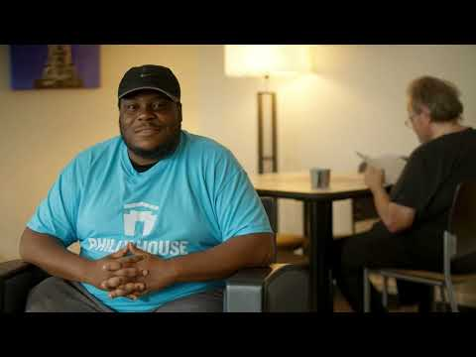
Case Study #1
Notes:
Embedded live results: https://www.mentimeter.com/app/presentation/al7tbevbxrhwyyogrnbzuq23nektbvrs

Slide 8
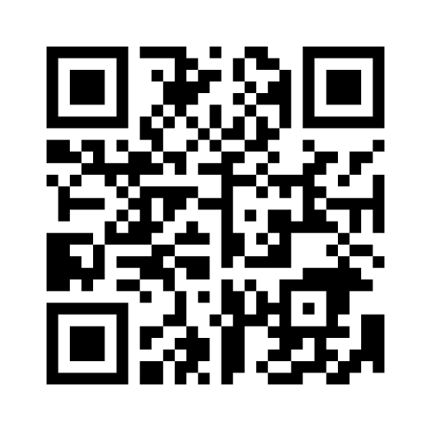
Case Study #1
Philly House received a grant and they want to explore the issue around a person that would utilize their services provided by organization.
Notes:
Embedded live results: https://www.mentimeter.com/app/presentation/al7tbevbxrhwyyogrnbzuq23nektbvrs
Address: : 302 N 13th St, Philadelphia, PA 19107
Single Layer Map Indicators
Zoom level: Philadelphia
Housing - > Chronic Homelessness
Income and Spending - > Food Insecurity
Income and Spending - > Persistent Poverty
Demographics - > Predominant Race

Slide 9
Case Study #2
Notes:
Embedded live results: https://www.mentimeter.com/app/presentation/aliio4s4xvtbf5bsi1962pifir536x7m

Slide 10
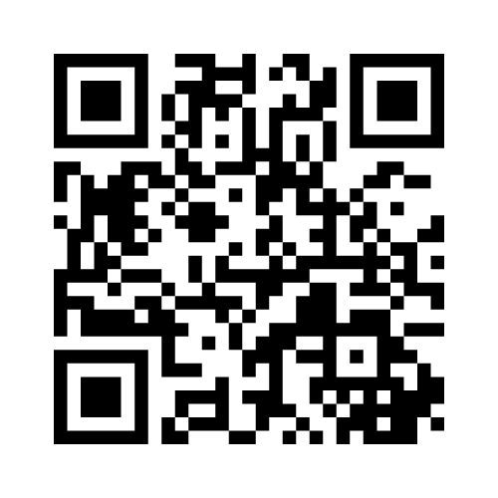
Case Study #2
What are the factors that go into creating a school to prison pipeline?
Notes:
Embedded live results: https://www.mentimeter.com/app/presentation/aliio4s4xvtbf5bsi1962pifir536x7m
Address: 1599 Wharton St, Philadelphia, PA 19146
Multi-Layer Map Indicators
Zoom level : Philadelphia
Quality of Life : Incarceration rates by Place of Childhood
Income and Spending - > Free and Reduced Lunch
Income and Spending - > SNAP vs. WIC
Quality of Life - > Food Access Data
Quality of Life - > Violent Crime
Education - > Public Schools point data
Education - > Public Schools: Teachers and Discipline (CRDC)
Education - > School performance - > High performing public schools
Search for - > preschool obesity

Slide 11
Reflection + Takeaways
How do these examples mirror your own communities?
Charles from Philly House: “At Philly House, they treat you as a human, not as a number or the statistics.”
Why are both necessary?
How can you envision yourself using PolicyMap to enhance your curriculum or research strategies?

Slide 12
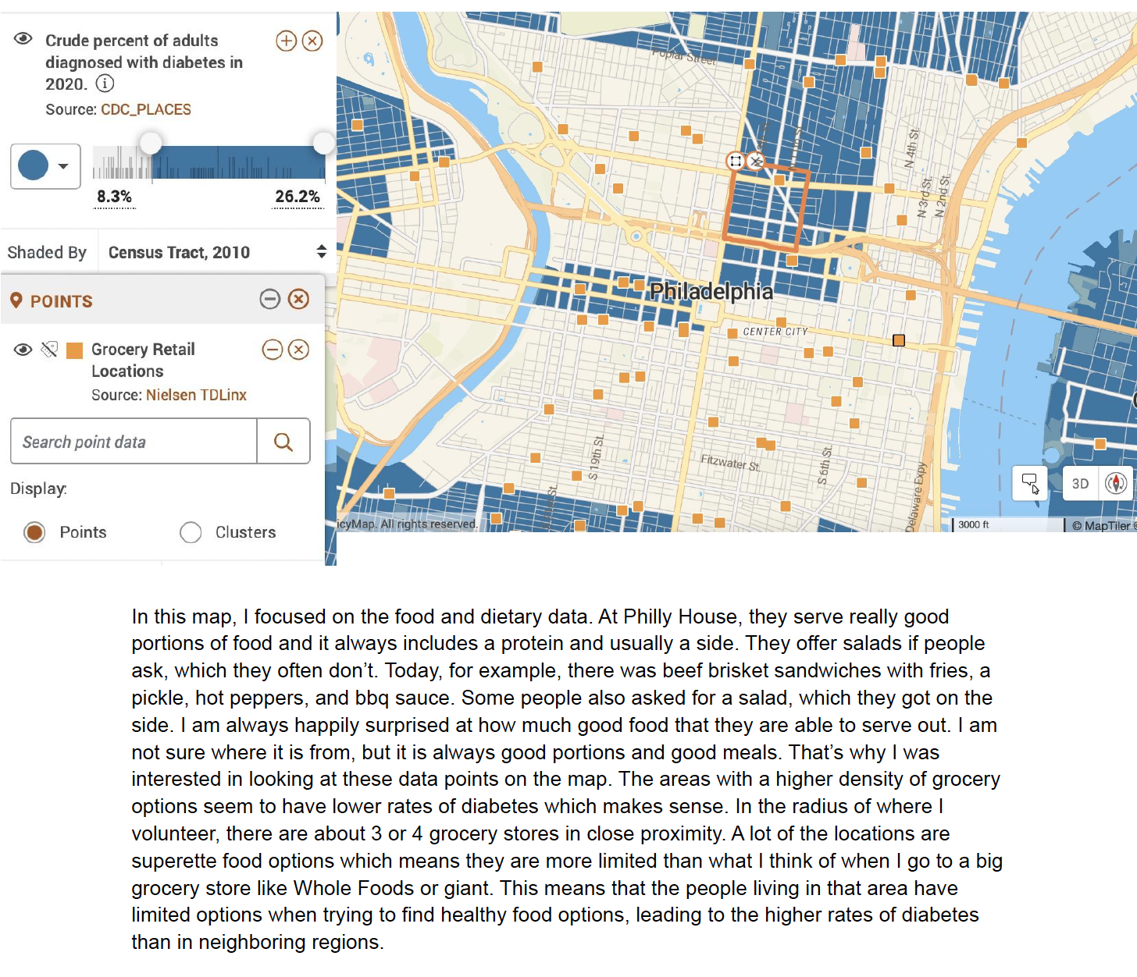
Connecting data and community: Ingrid Ellis
Notes:
POLICYMAPS 1.mov

Slide 13
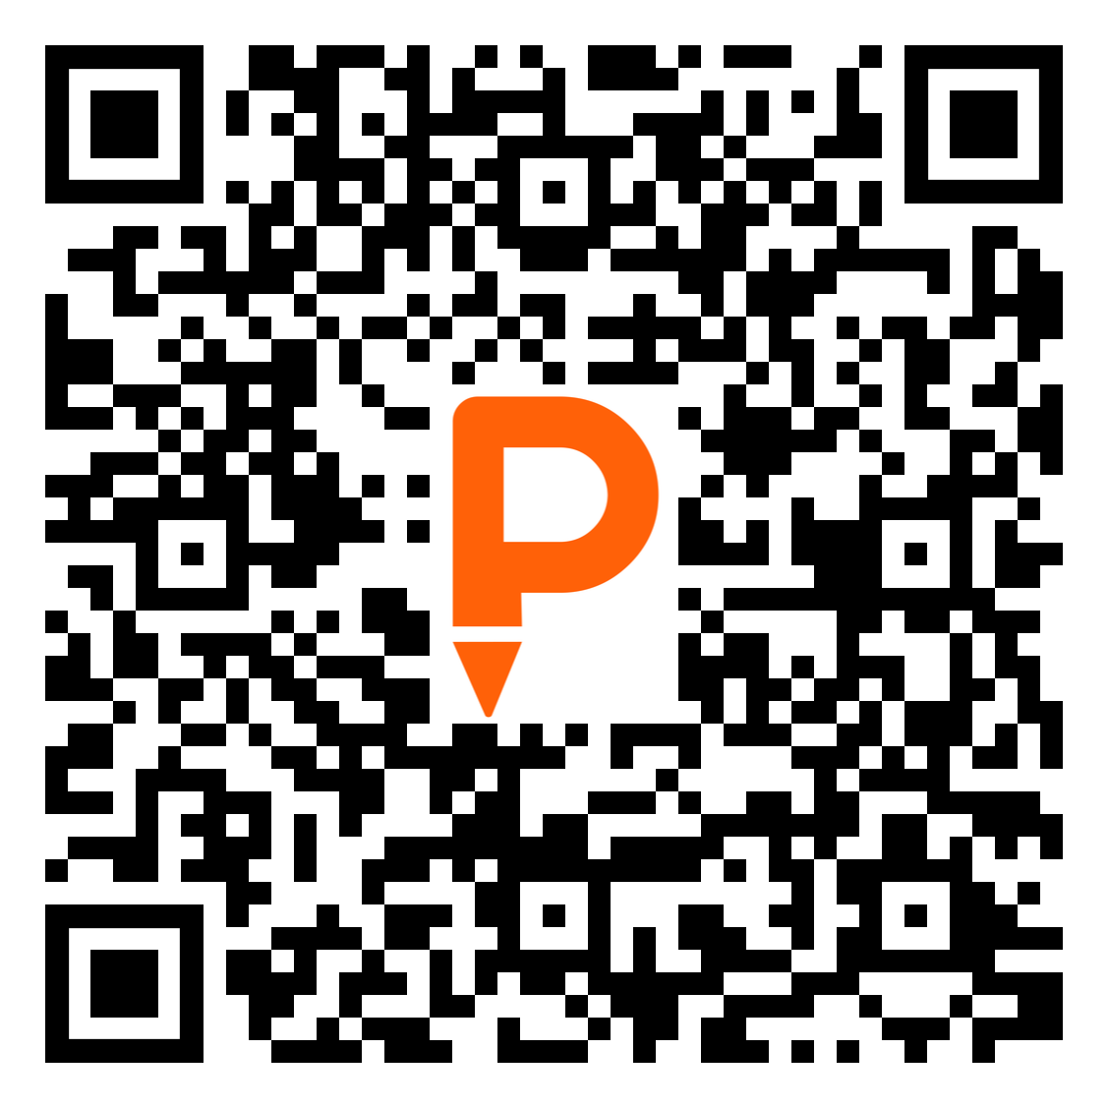
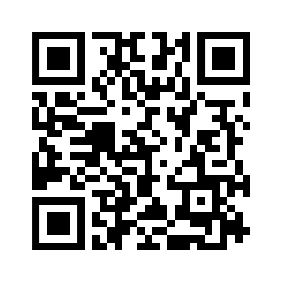
Thank you!
For future questions please reach out to:
PolicyMap Justice Studies
Notes:
Questions
https://westphillypn.org/how-we-measure-success/neighborhood-indicators

Slide 14
Connecting data and community: Ingrid Ellis
Notes:
POLICYMAPS 1.mov

